Slide 1
Review Management

Slide 2
Why Online Reviews Matter?

Slide 3
Online Reviews Matter to Consumers
Online content influences behavior, because consumers research your business.
97%
84%
of consumers read reviews for local businesses
of consumers trust online reviews as much as recommendations from friends or family
7 out of 10 consumers will leave a review when asked to do so.

Slide 4
Online Reviews Matter to YOUR Business
Greater quantity, better quality, and review recency all matter
Positive Review = new consumers and boost revenue
Negative reviews hurt your reputation
= $
40 positive experiences to undo 1 negative review
Each star increase leads to a 9% revenue increase for a restaurant
How you respond to reviews matters to potential customers
89% of consumers read businesses’ responses to reviews

Slide 5
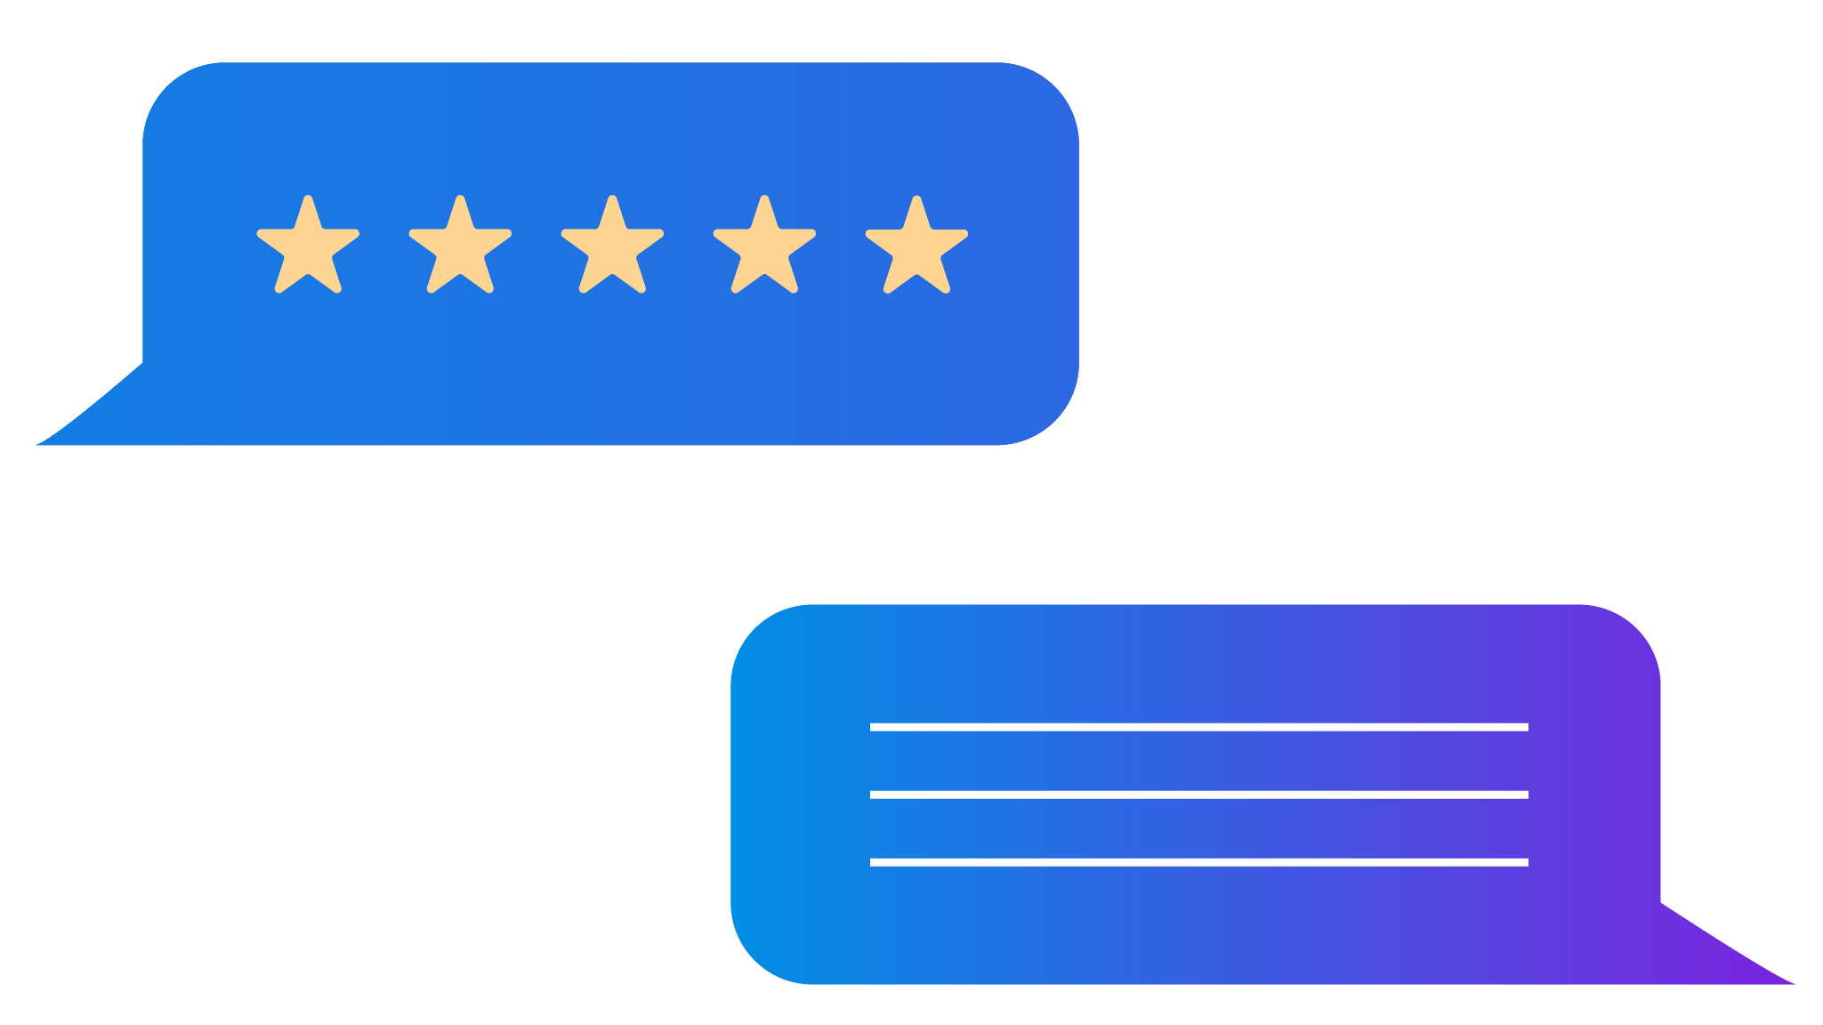
Online Review Challenges That You Face
5 key reputation pillars that shape how your consumers see you online.
1
2
3
Generating New Reviews
Improving Your Reviews
Monitoring New Reviews
4
5
Responding to Reviews
Sharing Reviews

Slide 6
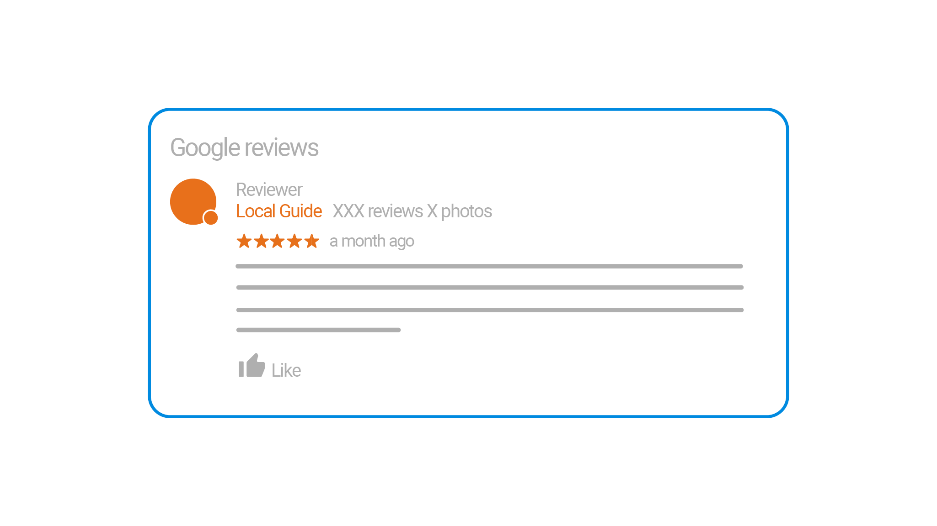
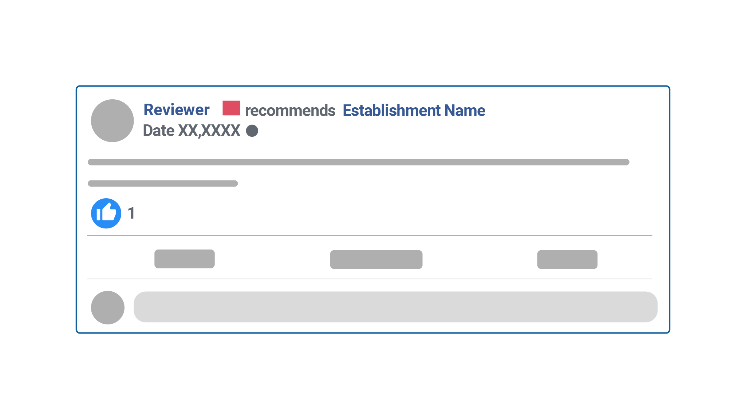
What are Online Reviews?
Online reviews are how consumers are able to provide feedback for businesses on the internet.
Name
Review Rating
Content of Review
Review on Website

Slide 7
Where To Get Online Reviews
Primary Sources
Yelp prohibits businesses from asking consumers for reviews.
Industry specific
There are numerous places online where you can see what’s being said about your business.

Slide 8
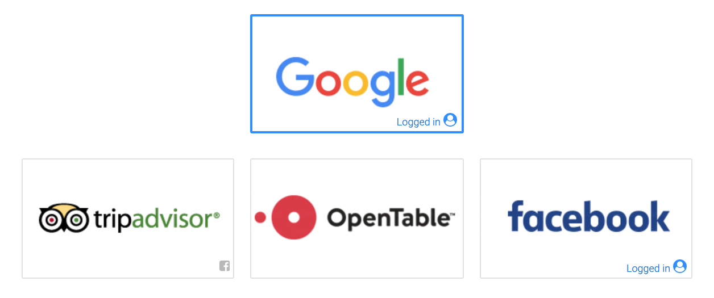
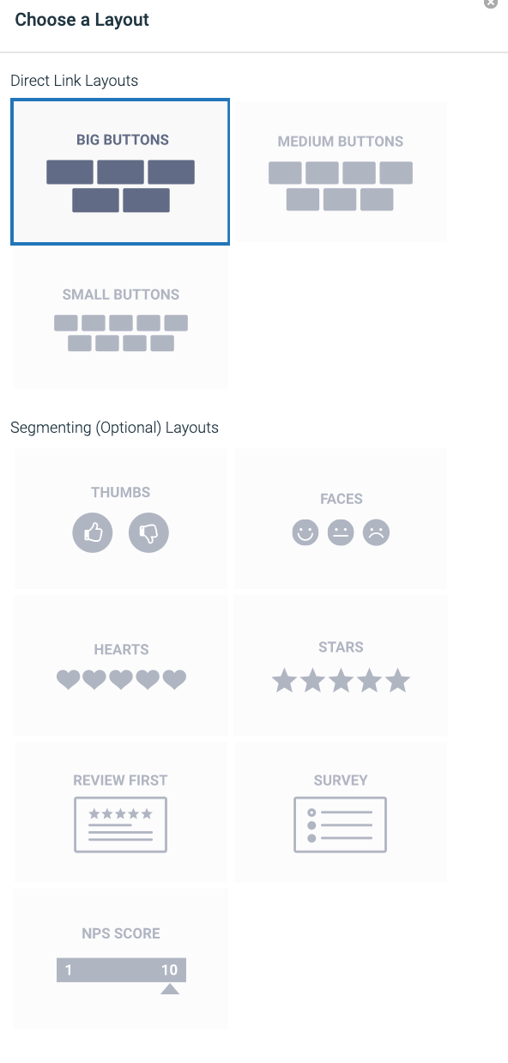
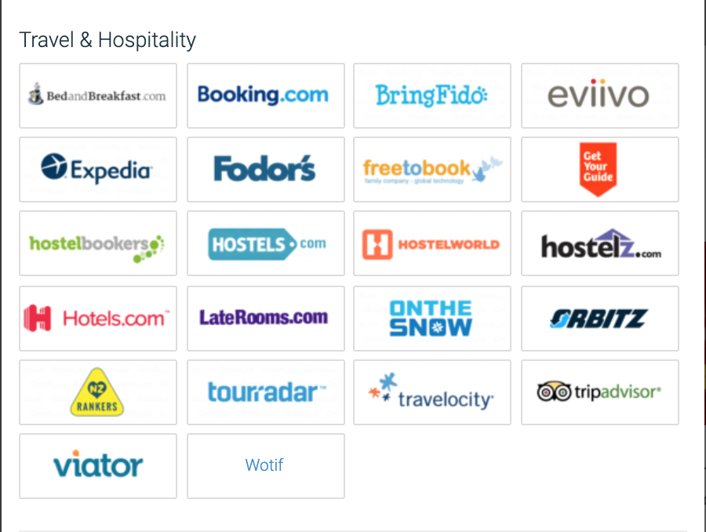
Choose Your Online Review Sites
Step 1: Choose Your Online Review Sites
Step 2: Set up your review funnel landing page
Step 3: Choose Your Layouts

Slide 9
Smart Site Services
Review and Reputation Management

Slide 10
Online Review and Reputation Management
Get the reputation you deserve
Review Generation
Review Monitoring
Review Sharing
Get great reviews. Boost your reputation.
Attract new customers.
Listen to customers. Show that you care. Win their loyalty.
Showcase your reviews. Blast on Twitter and Facebook. Stream to your website.

Slide 11
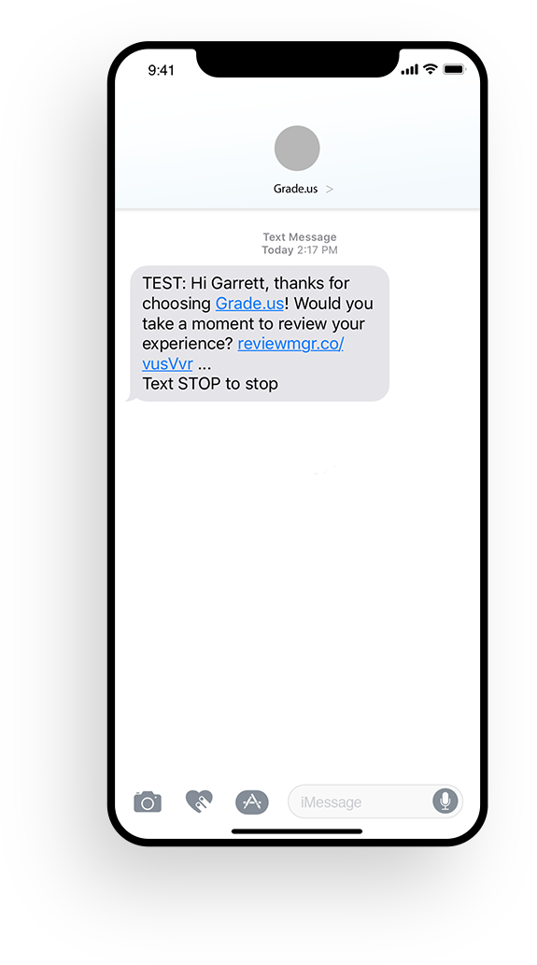
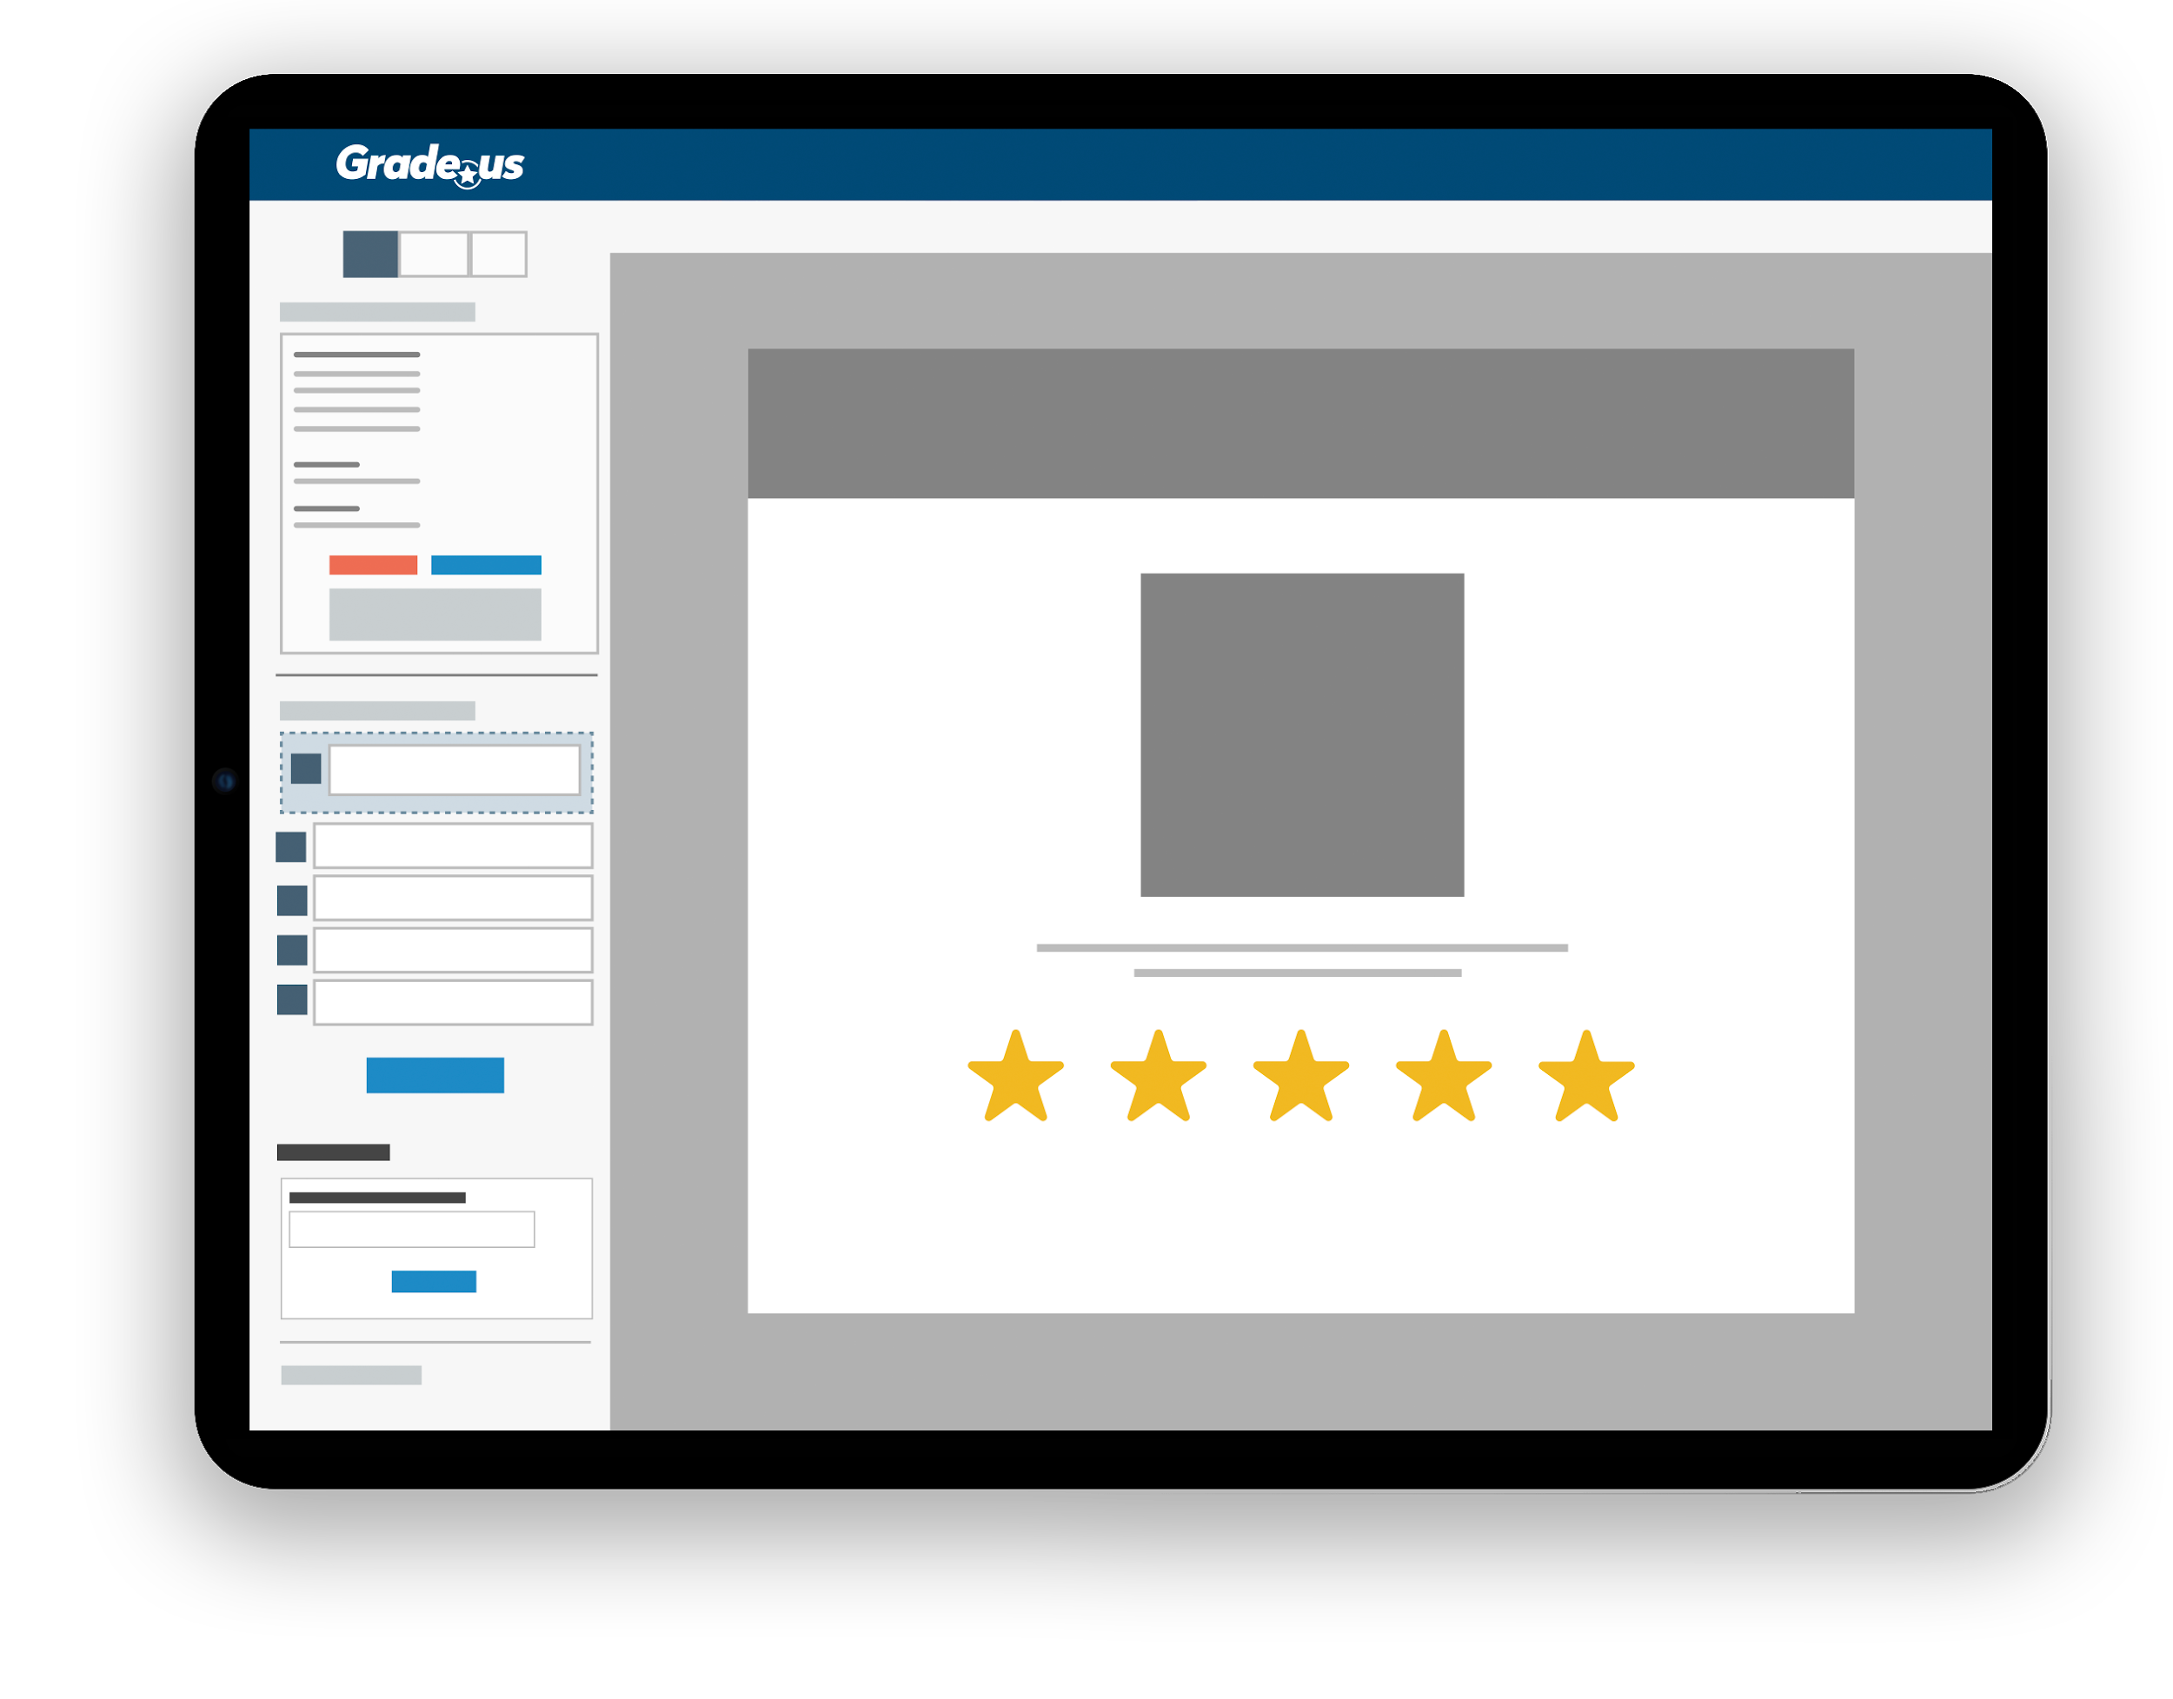
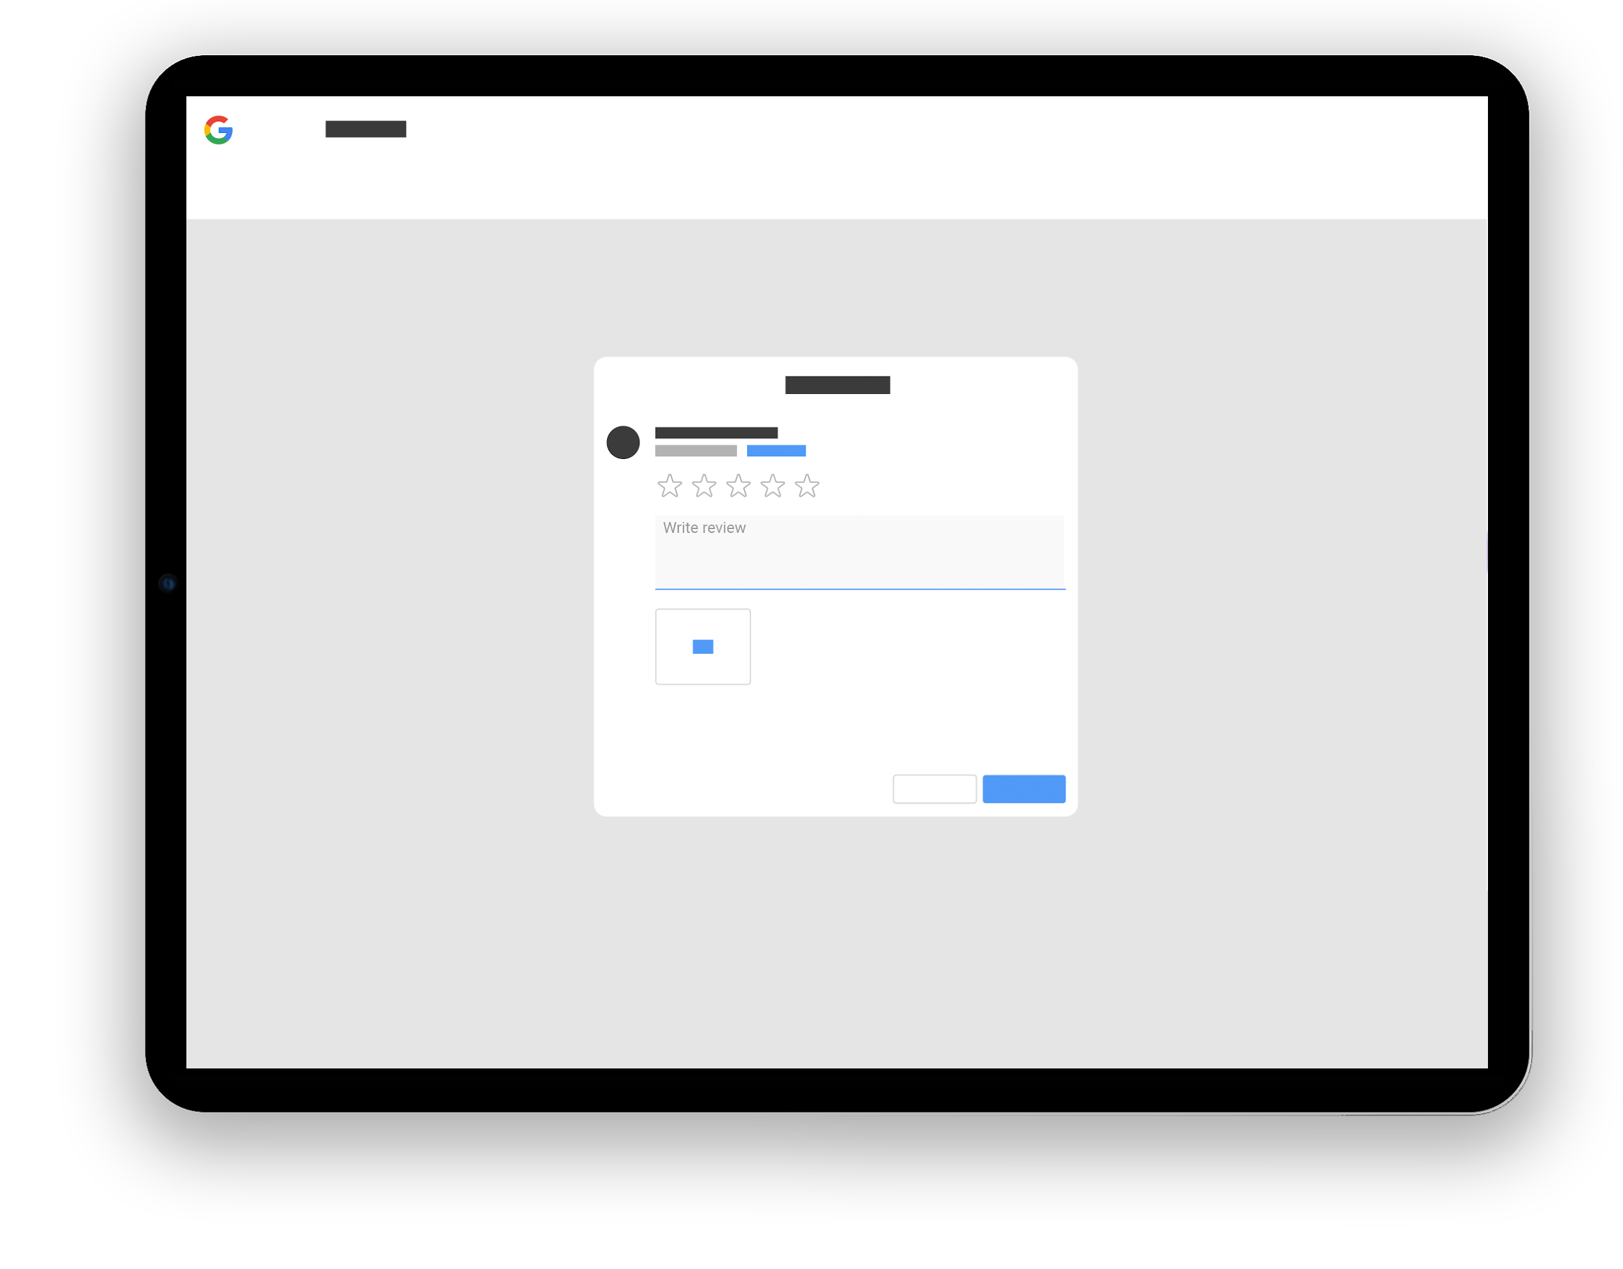
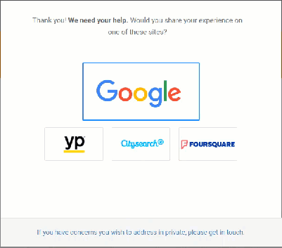
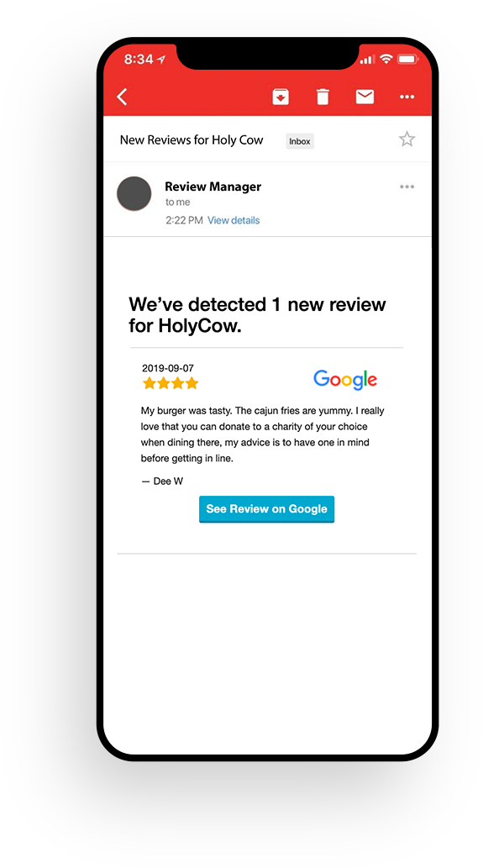
Challenges You Face: Generating and Improving Reviews
Generating
Improving
Problem to solve: You need a steady stream of online reviews across Google, Facebook, and your industry’s top review sites.
Solution: Provide customers with an easy review funnel path to writing a great online review on the review sites your prefer.
Experience: Customer receives an email or text that takes them to a website where they can easily choose a review site to write their review.
Measurement:
Review volume
Aggregate rating
Review Request
Review Funnel
Choose a Review Site
Write a Review

Slide 12
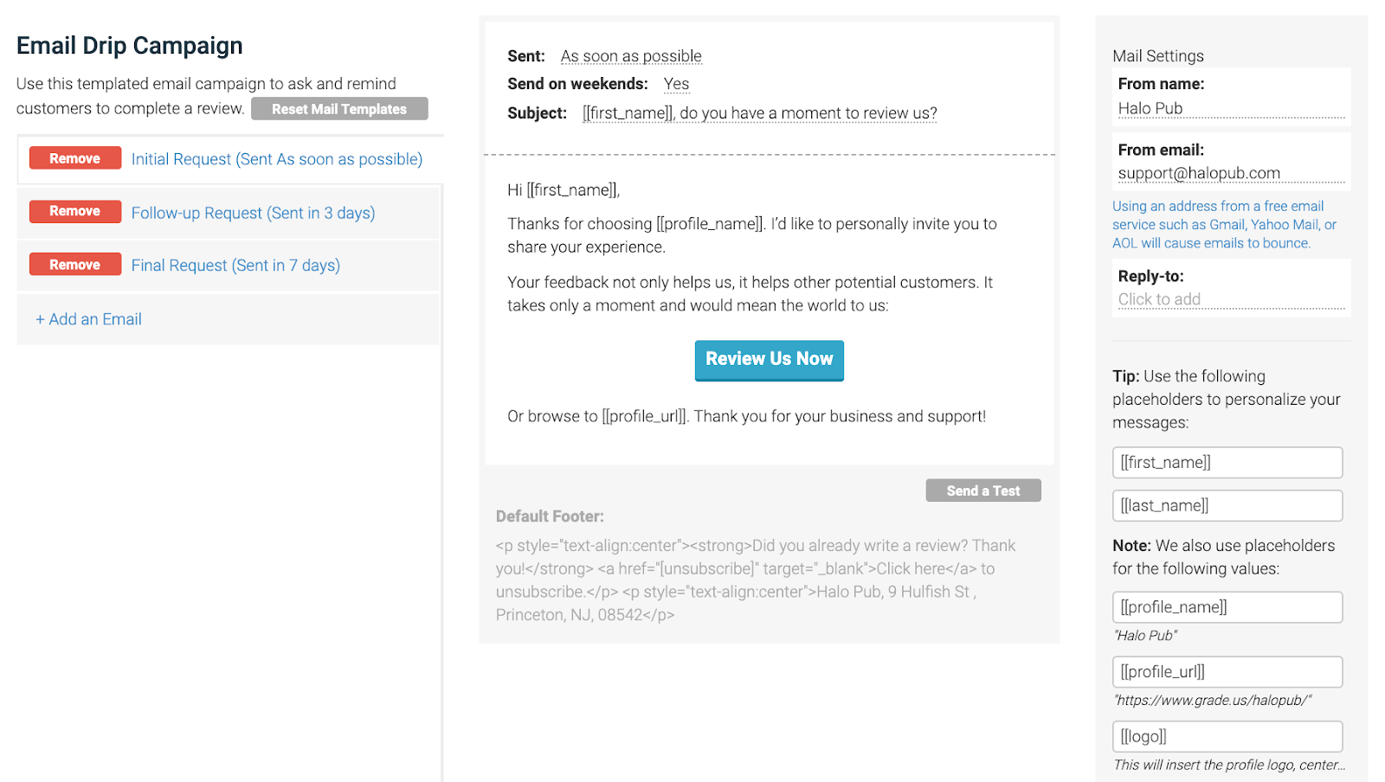
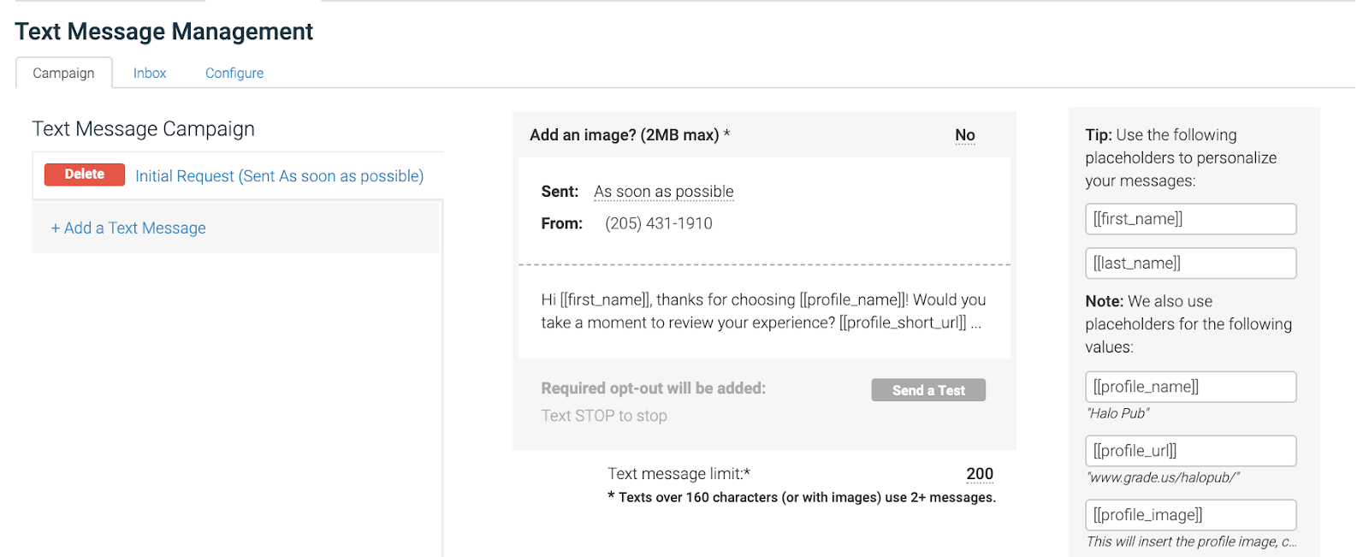
Step 1: Set Up Your Email Campaign
Review Generation Campaigns
Step 2: Set Up Your Text Campaign
Customize send times, content, personalization:
Choose a local number
and customize the content

Slide 13
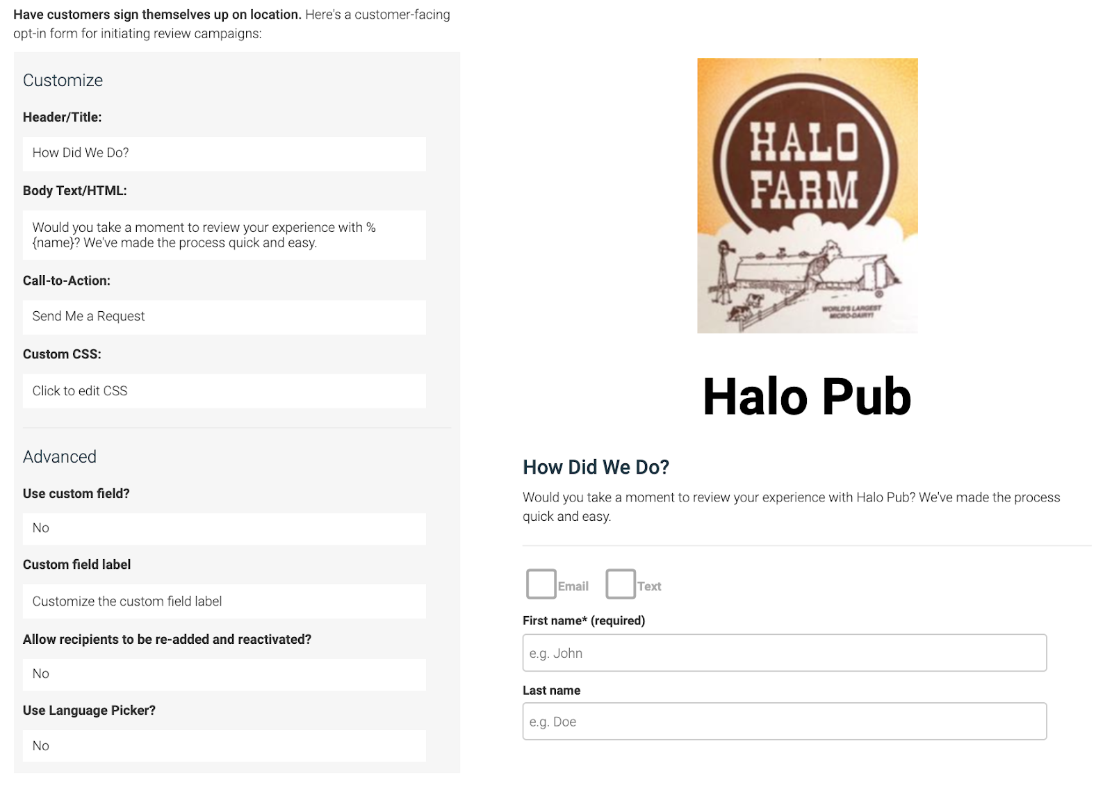
Adding Customers To Request New Reviews
Recipient forms for email and SMS review requests:
Invite Form
Opt In Form

Slide 14
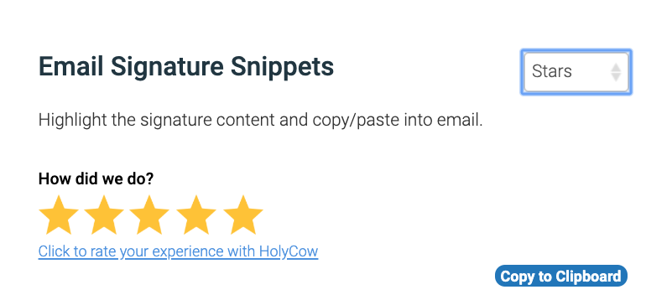
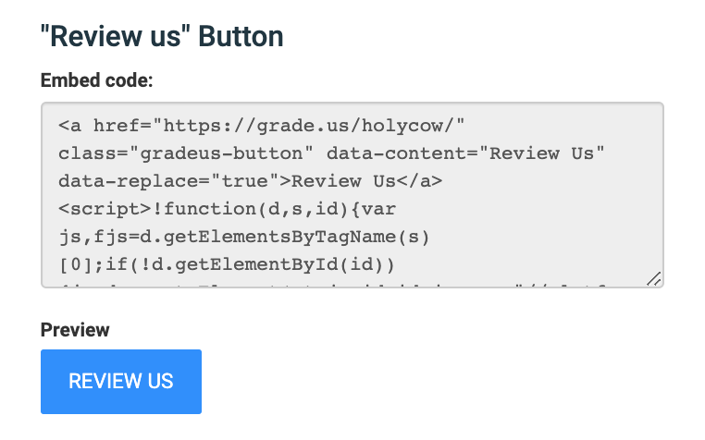
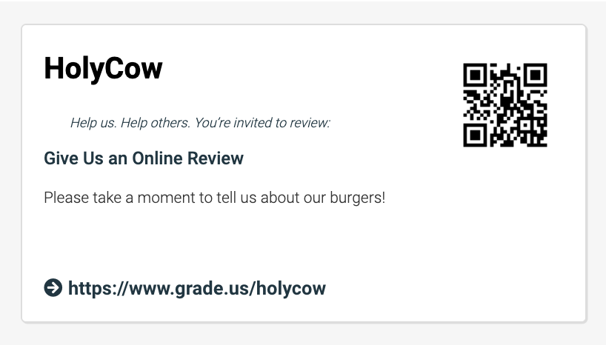
Tools to Help Generate New Review
Email signature snippet
Kiosk Mode
Upload Bulk CSV File of customer info
API Automation or Zapier Integration
Widgets: Button on website
Printed invite cards and QR Codes

Slide 15
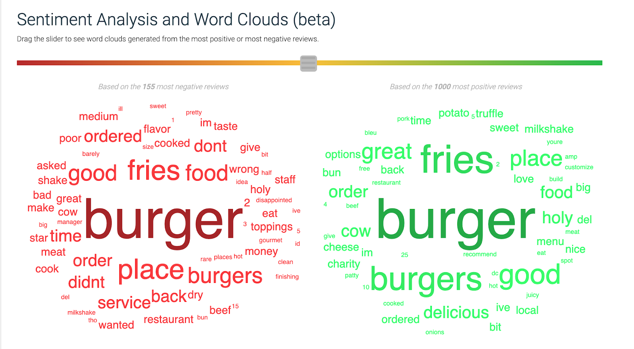
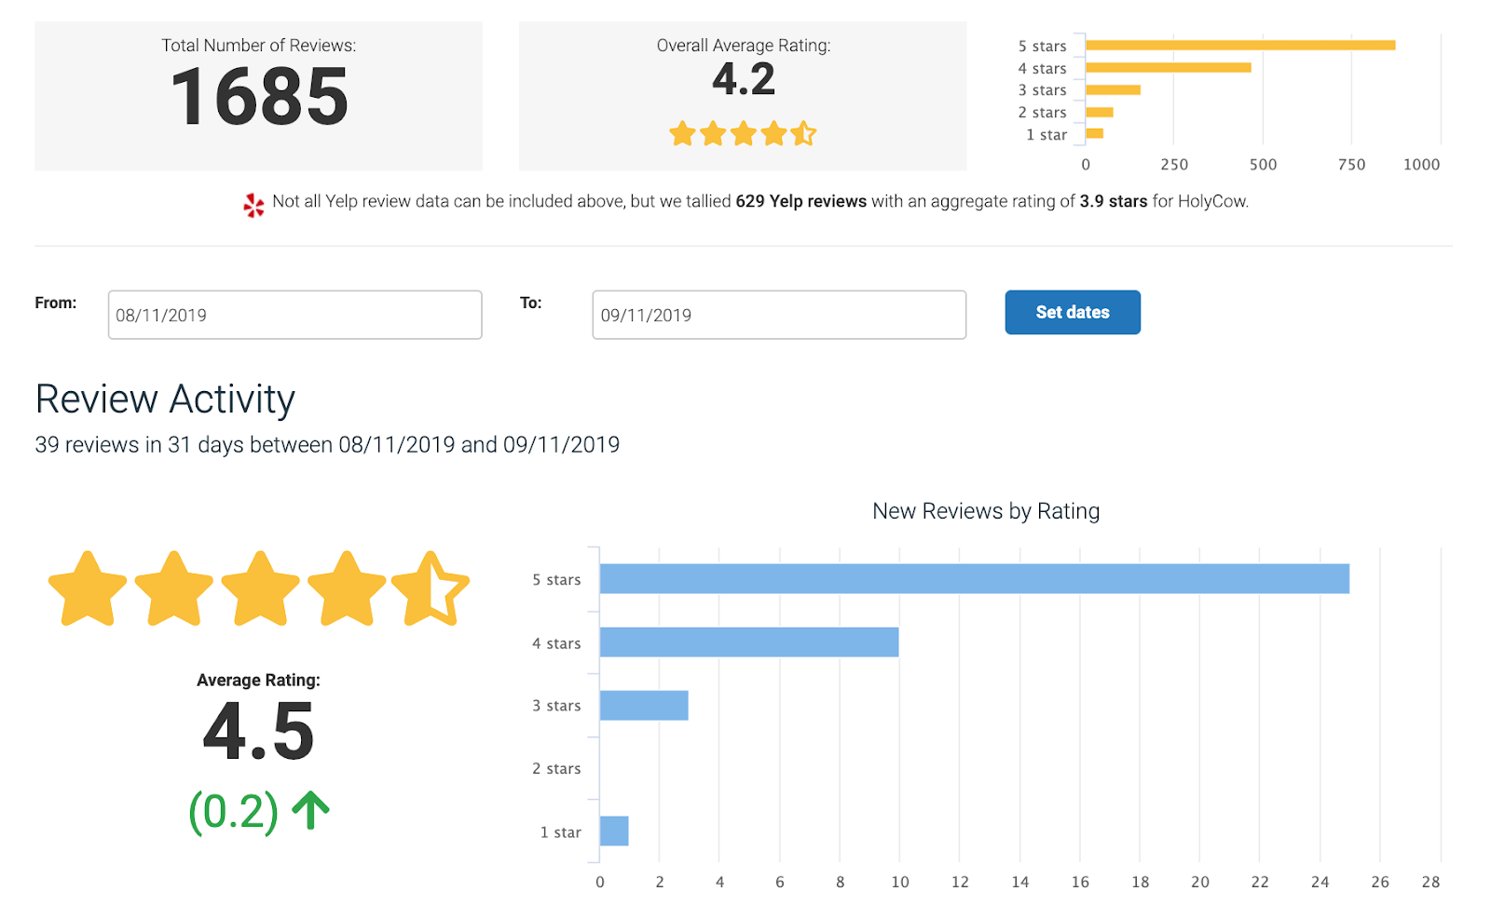
Reporting
Semantic word cloud:
Automated customized reports (top level and location level):
Review volume
Aggregate ratings
Campaign reports
Funnel click through reports

Slide 16
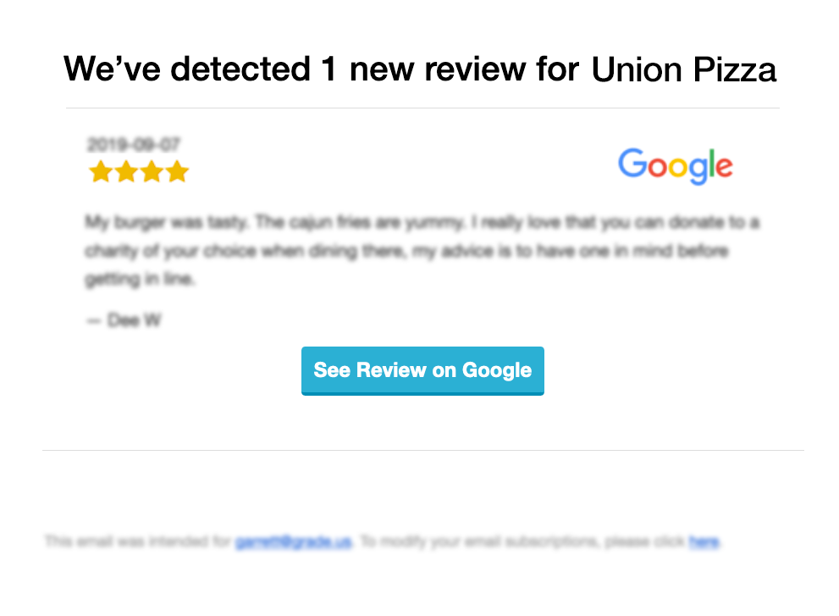
Challenges You Face: Monitoring and Responding to Reviews
Responding
Monitoring
Problem: You need to know when a customer writes a public online review about your business.
Solution: You and your team receive an email notification when you have a new review that you need to respond to.
Experience:
You are notified about the review.
Your team sends a positive response to resolve negative reviews and celebrate positive reviews.
Customer feels heard and appreciated.
Other potential customers see that you care.
Measurement:
Review responses volume
Improved review ratings
Higher website traffic from 3rd party review sites
You’ve got a new review
You can respond to Google and Facebook right from your dashboard!
Respond to a review

Slide 17
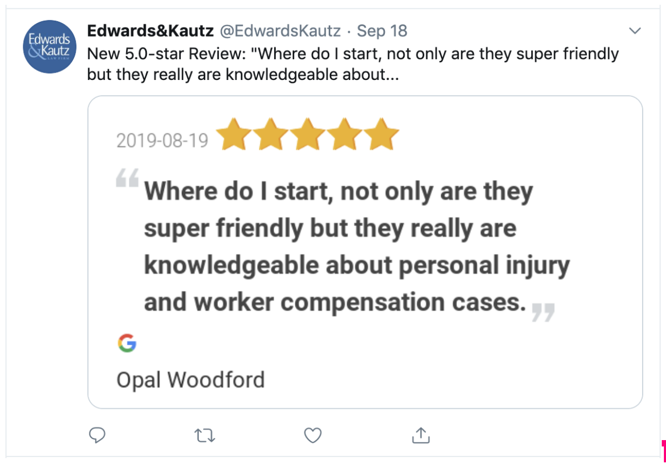
Challenges You Face: Sharing Your Great Reviews
Sharing
Problem: You need a way to use your user generated reviews as content in your marketing.
Solution: You can automatically share your best reviews on your company’s Twitter channel, Facebook feed, and stream them on your own website.
Experience:
Configure your sharing settings and connect your social media accounts.
Your team sends a positive response to resolve negative reviews and celebrate positive reviews.
Anyone who follows you on social sees your great reviews.
Measurement:
Increased social media followings
Improved social media engagement
Higher website traffic from social media
Business shares review on social media
Your Website

Slide 18
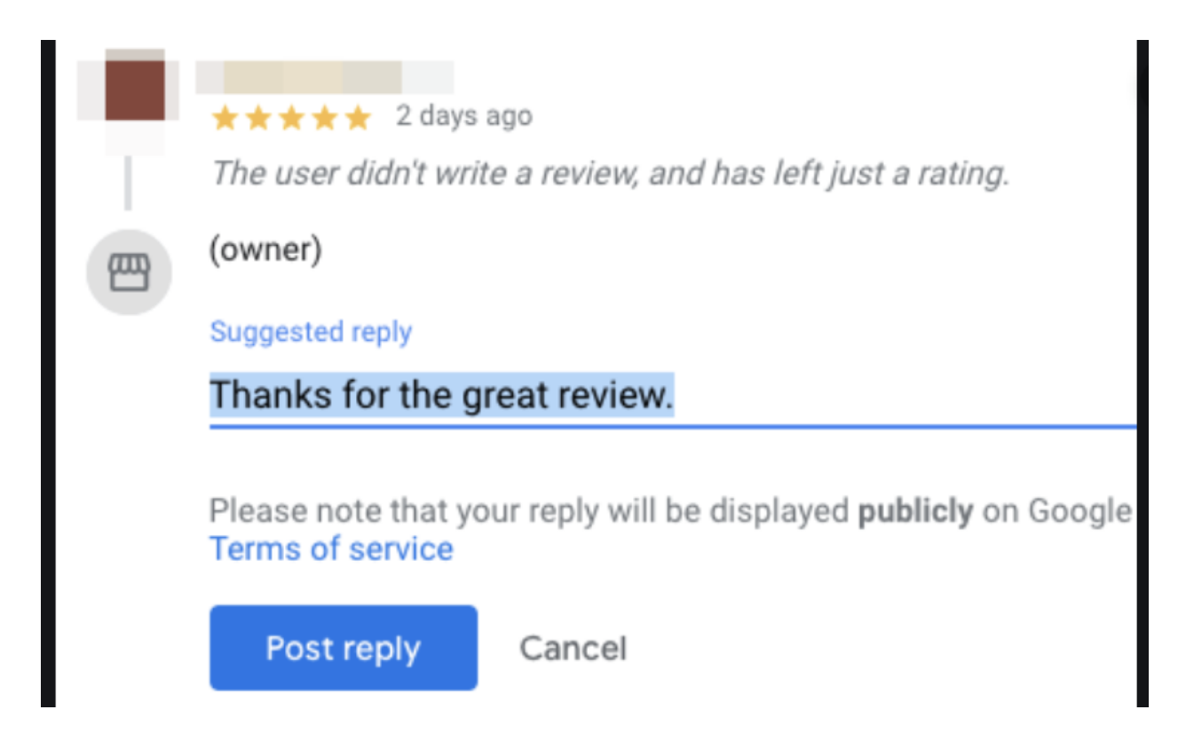
Timeline of an Online Review Journey
Customer visits review funnel
Customer writes review
Customer
Business
Business asks customer for review
Business receives review notification
Business responds to review on review site
Business shares review on social media

Slide 19
Only $120 Per Month!

Slide 20
Thank you & Questions?
SmartSiteServices.com
+1 (248) 270-5372

